Slide 1
Reactive
Microservices
Scopus

Slide 2
Agenda
Traditional way of Spring-Web application and its limitation
Nonblocking approach
Understanding reactive programming
Publisher, Subscriber, Subscription
Mono & Flux
Advantages, Disadvantages, when to use Reactive Design
References for reactive microservices in Scopus
Hands-On

Slide 3
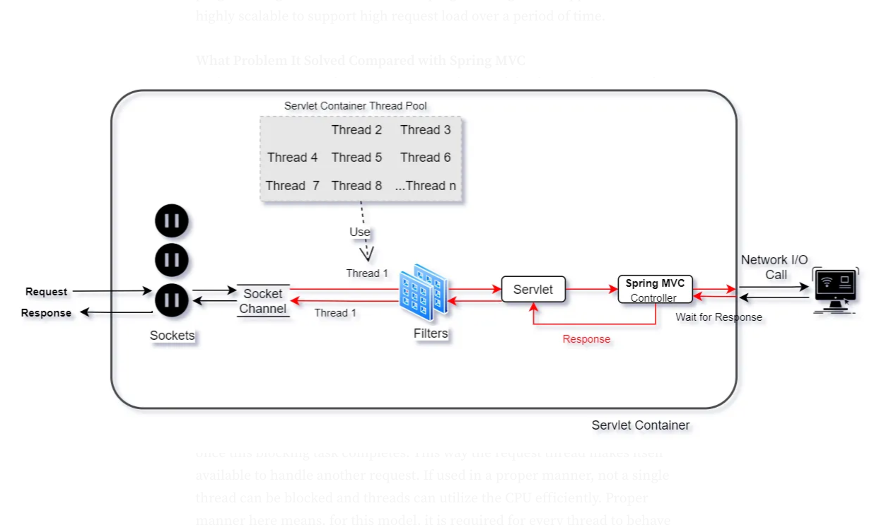
Traditional way of Spring-Web application and its limitation
How do we think ?
It's a single request
Multiple simultaneous users abstracted out
Delays abstracted out
At what cost ?
We pay with sequential blocking operations
We pay with idling threads

Slide 4
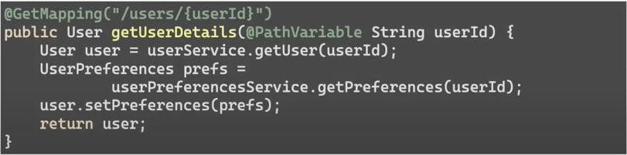
Guess the issue ?

Slide 5
What about concurrency APIs ?

Slide 6
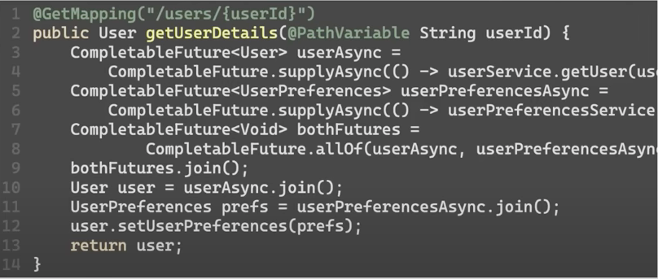
Java Concurrency APIs
Filters and Servlets are working synchronously
I/O operations are still blocking
No backpressure support (React to fast producers)

Slide 7
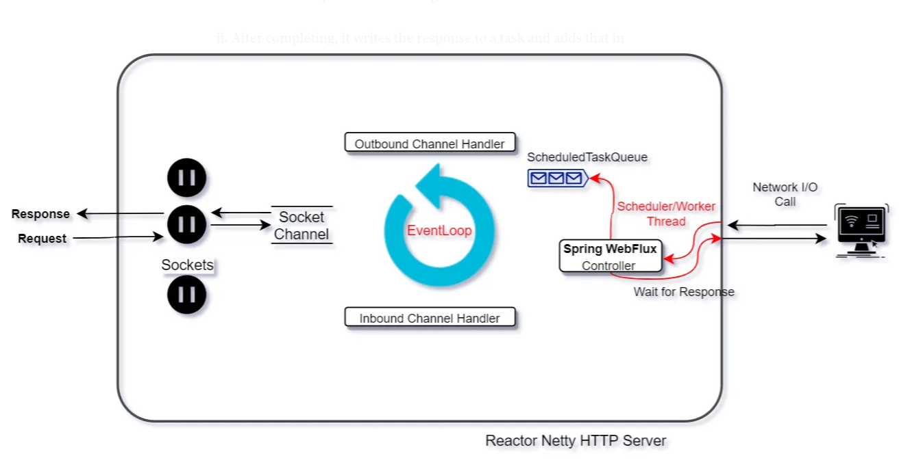
Non-Blocking approach with Worker Thread
All requests are received on a unique socket
Event loop is associated with set of Sockets channel
Event loop goes through inbound channel handlers/Webfilters
Event loop delegates request to a worker thread
Worker thread puts back the response in task queue
Event loop polls the task and applies outbound channel handlers
Handles back the response to same socket.

Slide 8
Still not perfect ?

Slide 9
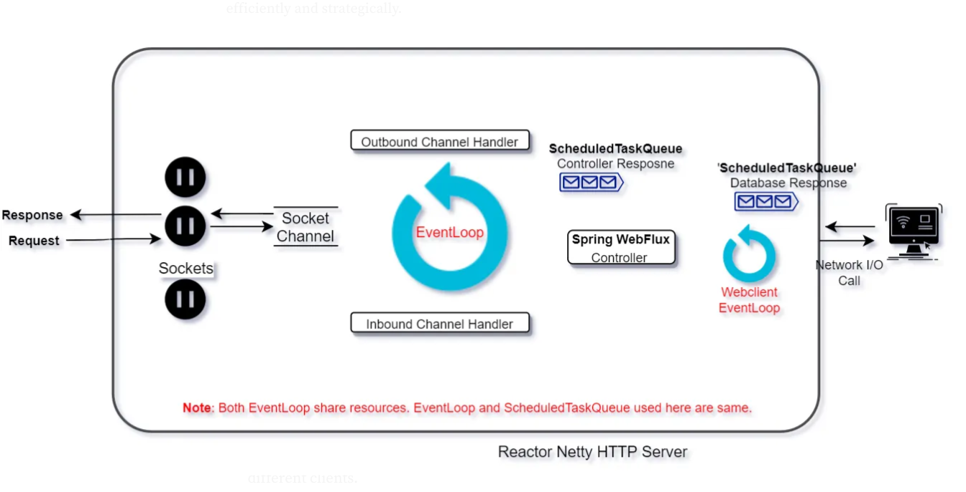
Fully Non-Blocking approach
Worker threads work in a blocking fashion in the previous approach
Adding an event loop/ task queue for I/O operations to use the worker thread efficiently.
Using Spring Webflux and its libraries to support fully asynchronous, non-blocking chain

Slide 10
What is Reactive programming ?
New programming paradigm
Asynchronous and non-blocking
Data flow as an event stream
Supports back pressure on data streams

Slide 11
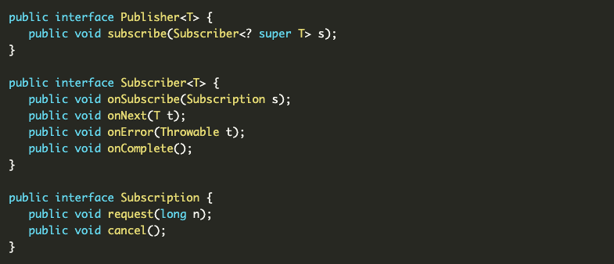
Reactive Stream Specification

Slide 12
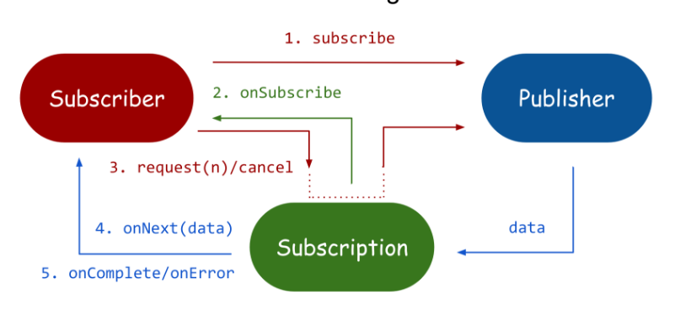
Reactive Stream Specification

Slide 13
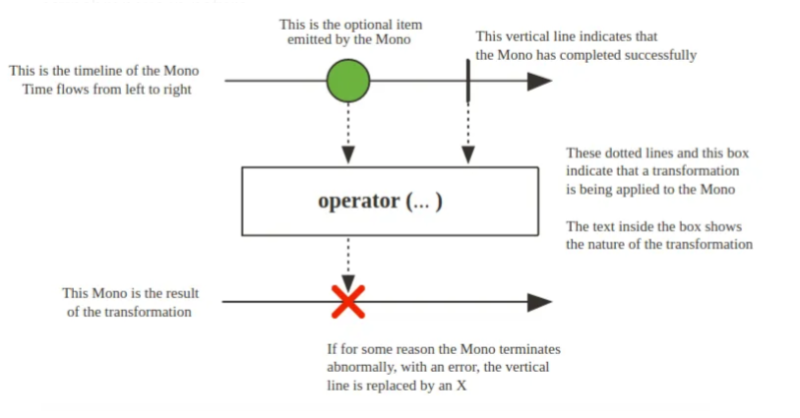
Mono

Slide 14
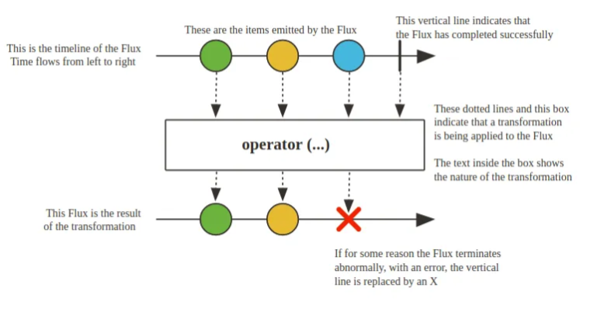
Flux

Slide 15

Assembly Line Analogy

Slide 16
Advantages
Can do more with less – higher performance can allow to consume less resources and reduce cost
Allows to process requests at higher capacity
Seamless multithreading
With proper use leads to cleaner code which is easier to read
Error handling becomes more organic
Event driven by design works better with Kafka, RabbitMQ, etc.

Slide 17
Disadvantages
Steep learning curve that requires mindset change
As multithreading is implied you might forget to account for it
Some coding mistakes can lead to a memory leak. Example from Android, but illustrates the issue: https://proandroiddev.com/memory-leaks-in-reactive-android-programming-a4ad2b34466a
Debugging becomes tricky

Slide 18
When to use Reactive Design
High data scale
High usage scale
Cloud based costs
Event-driven systems or systems using streams (e.g. Kafka)

Slide 19
References in Scopus to implement reactive design
Document Search microservice : https://github.com/elsevier-research/scopustech-document-search-service
Scopus Libraries : https://github.com/elsevier-research/scopustech-libraries
For request header authorization : scopus-service-authorization-reactive
For adding trace ids in logs : scopus-log-tracing-reactive
For Oauth calls support : scopus-oauth-library-reactive
For Feign Client library : scopus-search-service-client-reactive
Spring Data reactive : https://spring.io/projects/spring-data-r2dbc, https://spring.io/blog/2016/11/28/going-reactive-with-spring-data

Slide 20
Hands-On https://github.com/elsevier-research/scopustech-reactive-workshop

Slide 21
Questions

